Slide 1
Integrating Two Worlds: A Pathway for Native American STEM Students
Alexis Baca-Spry, M.A.T.
Coordinator, Multicultural Engineering Program
Northern Arizona University
Flagstaff, AZ

Slide 2
Overview
Goal: more Native American professionals at NNSA
Build on existing NAU programs effectively serving Native American students
Two summer programs
Targets Native American high school and college students
Cultural support
Jan 2011 - Dec 2013

Slide 3
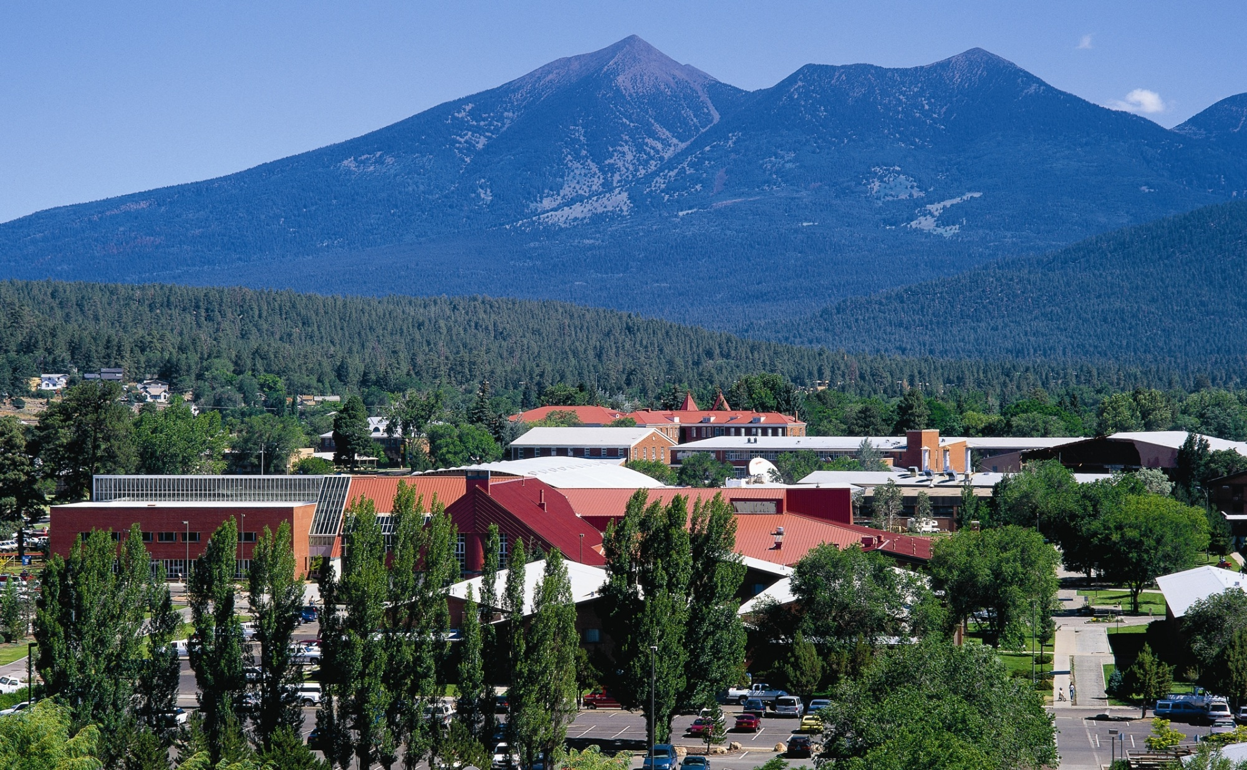
Northern Arizona University
Located in Flagstaff- 2 hrs north of Phoenix
State institution: 20,500 students
Main campus: 18,000 students
White 72%, Hispanic 12%, N. Am 6%, A. Am 2%, Asian Am 2%, Intl. 2%, not spec.

Slide 4
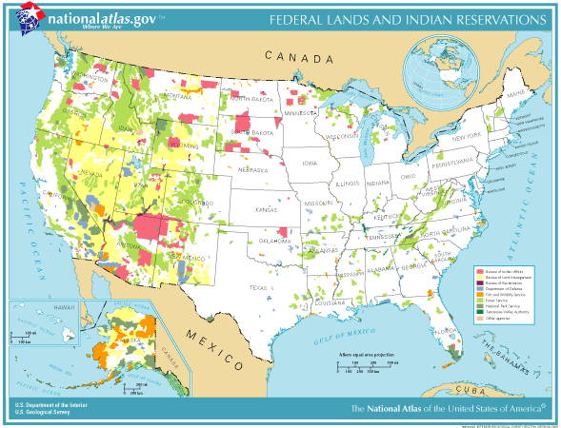

Slide 5
NAU Programs
Multicultural Engineering Program (MEP)
Established in 1994
Support for underrepresented populations
Advising, tutoring, mentoring, networking
Native American Student Services (NASS)
Academic and cultural support
Nizhoni Academy
Started in 1984
Bridge program

Slide 6
Past Successes
STEP UP
TECH UP
Upward Bound/Nizhoni
NASS Summer Bridge
STAR Program

Slide 7
Recruitment
MEP and NASS already have strong connections
Utilize multiple communication modes with eligible students
Student meetings, conferences, career fairs, advising sessions, emails, workshops, teachers, guidance counselors.

Slide 8
High School Summer Program
Nizhoni Academy
5 week residential experience on NAU campus
Academic focus for college preparation
Science and engineering faculty participate
Academic majors and career options
NNSA Youth Symposium
Culmination event, 1 day
NASS recruits students
Increase attendance from 20 to 30

Slide 9
Undergraduate Summer Program
10 week internship at LLNL
Stipend and travel
Students
Up to 7 undergraduate students
Up to 2 graduate students
Projects supplied by LLNL/NNSA
NAU MEP program recruits students
Primarily from NAU population
Possibly from ASU and UA

Slide 10
Assessment of Programs
Internships at LLNL
Student retention in STEM major
Performance of interns at LLNL
Nizhoni Academy
Interest in STEM majors, intended major, projection of college attendance
Tracked for admission
NNSA Youth Symposium feedback
Impact on attendees knowledge of STEM careers, NNSA, professional development attitudes

Slide 11
Project Deliverables
Nizhoni Academy with NNSA Youth Symposium
MEP-LLNL Internship
Cultural Support
Traditional and modern

Slide 12
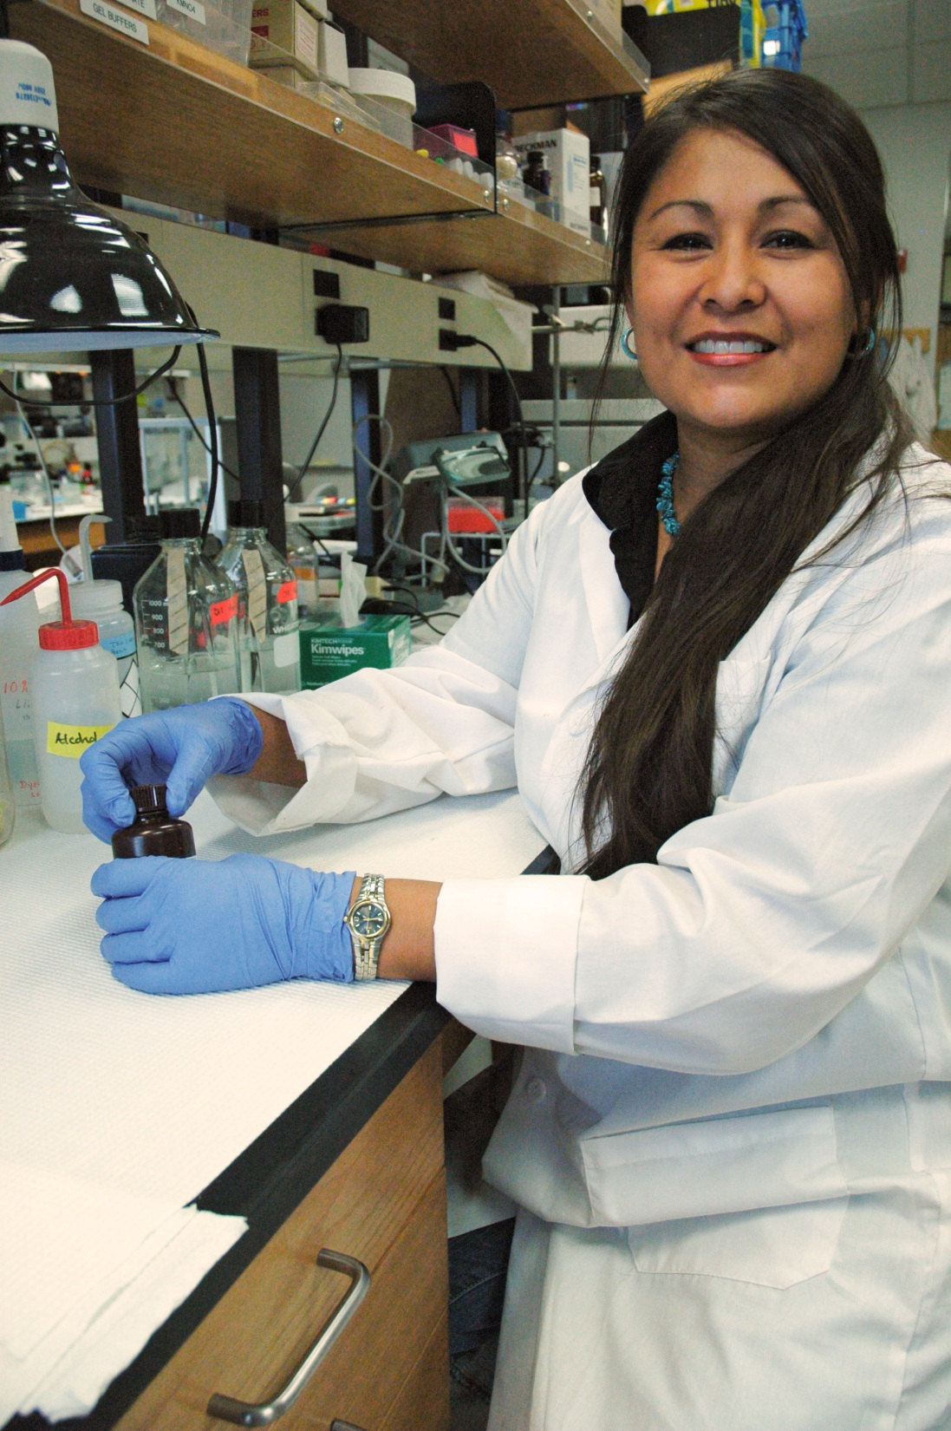

Slide 13
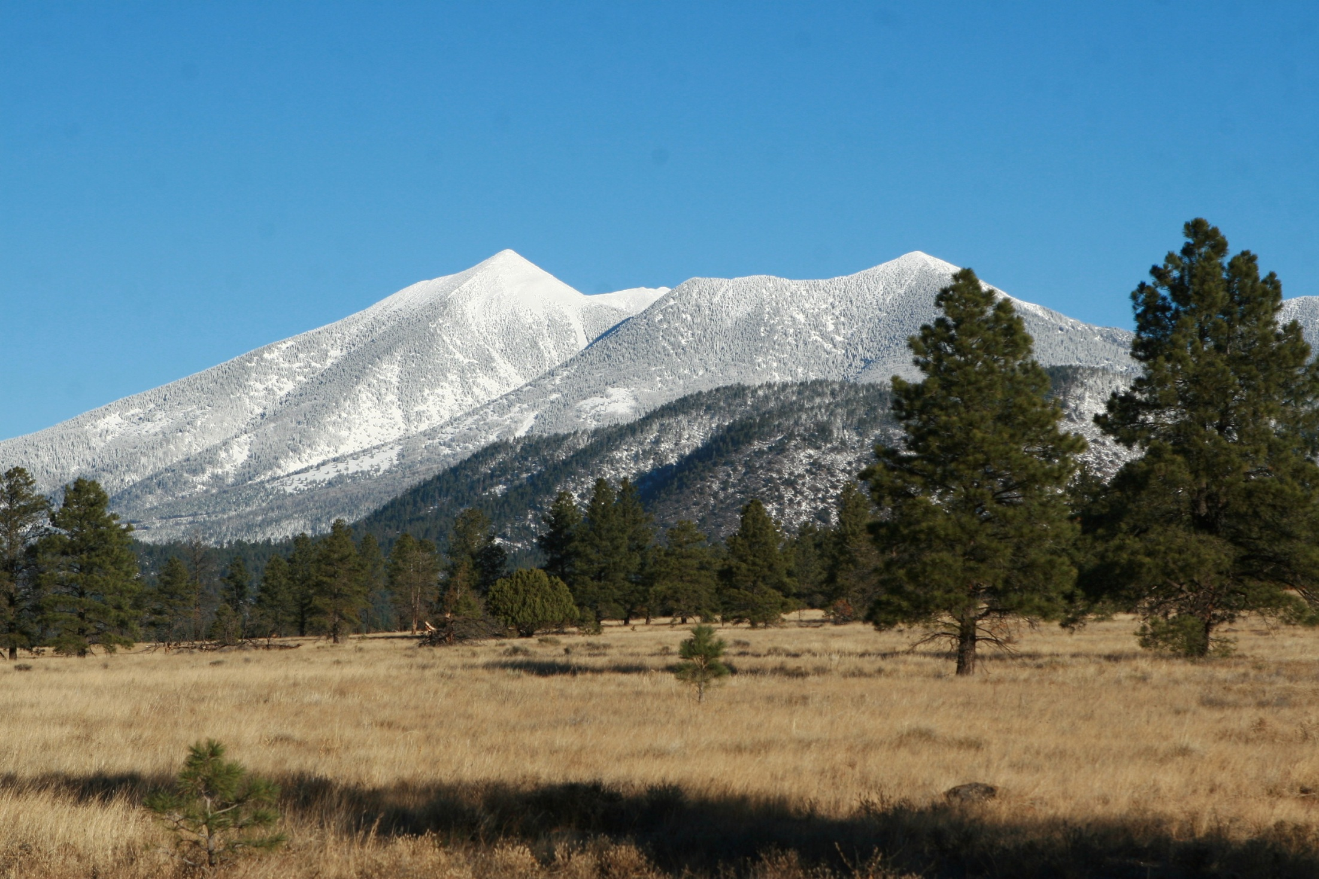
QUESTIONS?

